Slide 1
Optimizing Trading Strategies with Reinforcement Learning
Amulya Saxena
Travis Desell

Slide 2
Agenda
Background
Domain and Architecture Models
Demo and code
Deliverables
Conclusion

Slide 3
Background
Stock Market Fundamentals
DJI
Time Series Analysis
Reinforcement Learning
Notes:
Dow Jones Industrial Average (DJI): The DJI is one of the oldest and most widely recognized stock market indices in the world. It tracks the performance of 30 large, publicly-owned companies based in the United States, often referred to as "blue-chip" stocks. Understanding the composition, behavior, and historical performance of the DJI is crucial, as it provides insights into the broader market trends and economic health.
Reinforcement Learning (RL): RL is a type of machine learning where an agent learns to make decisions by performing actions and receiving feedback in the form of rewards or penalties. In the context of stock trading, the agent would make buy, hold, or sell decisions based on stock price data and receive rewards based on the profitability of those actions.
Stock Market Fundamentals: A solid understanding of stock market fundamentals, including how stocks are bought and sold, what influences stock prices (such as earnings reports, market sentiment, economic indicators), and basic financial metrics, is essential. This knowledge aids in interpreting model predictions and formulating effective trading strategies.
Time Series Analysis: Since stock prices are time series data, familiarity with time series analysis is crucial. This includes understanding concepts like trend, seasonality, and noise, as well as statistical models and techniques used to analyze time-dependent data sequences.

Slide 4
Related Work

Slide 5
Reference | Title | Area/Method
https://ssrn.com/abstract=3690996 | Deep Reinforcement Learning for Automated Stock Trading: An Ensemble Strategy | Reinforcement learning(RL)/Ensemble
http://hdl.handle.net/11250/2622891 | A Deep Reinforcement Learning Approach to Stock Trading | RL algorithms
https://doi.org/10.1016/j.knosys.2021.107119 | Technical analysis strategy optimization using a machine learning approach in stock market indices | Trading Strategies Optimization/ML
https://doi.org/10.17762/sfs.v10i2S.874 | Investment Strategies in Indian Stock Market Using Vader Algorithm Sentimental Analysis | Investment Strategies/Sentiment Analysis
https://doi.org/10.1016/j.eswa.2023.122801 | A novel Deep Reinforcement Learning based automated stock trading system using cascaded LSTM networks | RL/LSTM models

Slide 6
Trading Strategies
Hybrid models combine ml models with traditional trading signals, applied to major stock exchanges.
Evaluates various models like ANN, Random forests, SVR against metrics like MSE and RMSE, integrates trading strategies like EMA and measures outcomes with profit factor, number of trades, etc.
Hybrid models using linear models and ANNs outperforms conventional methods like TEMA in profitability and risk management.
Studies use VADER algorithm to assess sentiments of sensex stocks ranging over a decade, categorizing them in positive, negative or neutral based polarity scores for short term investment.
Notes:
Polarity scores are numerical values assigned by sentiment analysis algorithms to quantify the emotional valence of text data, indicating whether the expressed sentiment is positive, negative, or neutral. These scores are often normalized within a specific range, such as -1 to 1, where:
Positive values indicate positive sentiment, suggesting favorable opinions or feelings towards the subject matter.
Negative values reflect negative sentiment, indicating unfavorable opinions or adverse emotions associated with the content.
Values around zero typically represent neutral sentiment, meaning the text does not convey significant positive or negative emotions.
Sentiment analysis tools like VADER (Valence Aware Dictionary and sEntiment Reasoner)

Slide 7
Reinforcement learning
Studies use innovative ensemble trading strategies leveraging deep reinforcement learning.
Models like Cascaded LSTM are used to effectively mine hidden insights from data. Tested on major global indices. Benchmarked against models like buy and hold, multilayer perceptron policy and other models.
RL agents are trained on features extracted from LSTM models.
Experimental results show model outperforms baseline models and accuracy improvement rates range from 5% to 15%. This also indicates a promising way to build an automated trading system.
Notes:
We introduce a DRL-based stock trading system utilizing a Cascaded Long Short-Term Memory (CLSTM-PPO Model) to effectively mine hidden insights from daily stock data, addressing the common challenge of low signal-to-noise ratios in financial datasets.
The system is tested across major global indices—DJI, SSE50, SENSEX, and FTSE100— and is benchmarked against traditional and contemporary models, including buy-and-hold, MLP, and LGBM strategies, demonstrating superior performance in key financial metrics.
Our findings reveal enhancements in cumulative returns, maximum earning rates, and average trade profitability, with improvements ranging from 5% to 52%, showcasing the potential of our approach in revolutionizing automated stock trading systems.

Slide 8
Proposed Project and Approach

Slide 9
Agenda
Overview
Updated Domain and architecture Models
Deliverables
Gantt Chart

Slide 10
Overview

Slide 11
Proposed Project
Develop an agent to learn trading strategies for the DJI stocks leveraging reinforcement learning.
Create a system that can adapt to market changes and optimize strategic decisions in real time aiming to maximize returns.
Evaluate trading strategy performances using metrics and choose which the model will use.
Notes:
A reinforcement learning (RL) trading agent learns stock trading strategies by analyzing historical market data, making buy/sell/hold decisions to maximize returns.
adapts to market changes using trial-and-error
Metrics such as profit factor, number of trades, net profit, average profit per trade.

Slide 12
Optimizing + Reinforcement Learning
What it is : RL + Trading Strategies
Goals
Learning from the Stock Market
Trading Decisions
Increase Profitability
Notes:
learn from stock market to understanding market behavior
Over time, the RL agent would refine its trading strategy to maximize the cumulative reward
Based on its analysis the RL agent would make trading decisions, such as whether to buy, sell, or hold a stock at a particular time step, right now I am aiming to make the agent give a decision for the next day, the ideal goal is to reach an hourly decision
- Informed Trading Decisions: To enable investors to make more informed decisions by employing adaptive trading methods that respond to real-time market conditions.
- Increased Profitability: To aid investors and financial institutions in improving their profitability and portfolio management through optimized trading strategies.

Slide 13
Approach
Semester 1 - Foundations
Literature Review and setting up framework
Conduct extensive review focusing on RL algorithms.
Define objectives and scope of the project.
EDA and Preprocessing
Feature Engineering
Finding financial indicators that will work best for modeling.
Initial Model development
Develop LSTM models, understand time series data patterns.
Run experiments with simple reinforcement models to establish a baseline.
Evaluation and Report

Slide 14
Approach – Semester 1
Extensive review
Setup framework
Statistical Analysis
Data Preprocessing
Creating new features
Finding financial indicators
Develop baseline models
Run experiments
Literature Review
EDA
Feature Engineering
Model Development
Notes:
Financial indicators like –
Price indicators – moving averages(average stock prices over a specific period), relative strength index (shows which stocks are overbought or oversold)

Slide 15
Approach – Semester 2
Simulate trend following, momentum-based strategies.
Let Agent explore and learn in environments
Configure Database
Develop UI
Document process, results
Present findings
Develop models
RL integration
UI and Database
Documentation
Notes:
RSI Indicator Stategy
supporting indicator
price needs to reject atleast 3 times before becoming support and resistance
https://youtu.be/MW3oHn7qJ_U?si=mH5LQneZ6YnvbA_V
MACD indicator
MACD divergence
200 MA
Moving Average Convergence Divergence (MACD) indicator, which is a momentum indicator used to follow trends and identify potential buy or sell signals. It combines moving averages to show changes in momentum and can be used to identify bullish or bearish market conditions.
ATR
Average true range
Average True Range (ATR) measures market volatility by calculating the average range between the highest and lowest prices over a specified period, accounting for gaps and price changes.

Slide 16
Approach
Semester 2 – Advanced Model Development
Develop models for trading strategies
Simulate Trend following, momentum based and mean reversion strategies.
Integration with RL Agent
Let agent explore and learn from environments.
Model Selection and Testing
Comprehensive testing, fine tune parameters, optimize learning process.
Performance Evaluation
Evaluate results from semester 1 models and other models available in the same area of research.
Documentation and Presentation
Document the process, testing methodologies and results.
Prepare presentations and report findings.

Slide 17
Domain Model

Slide 18
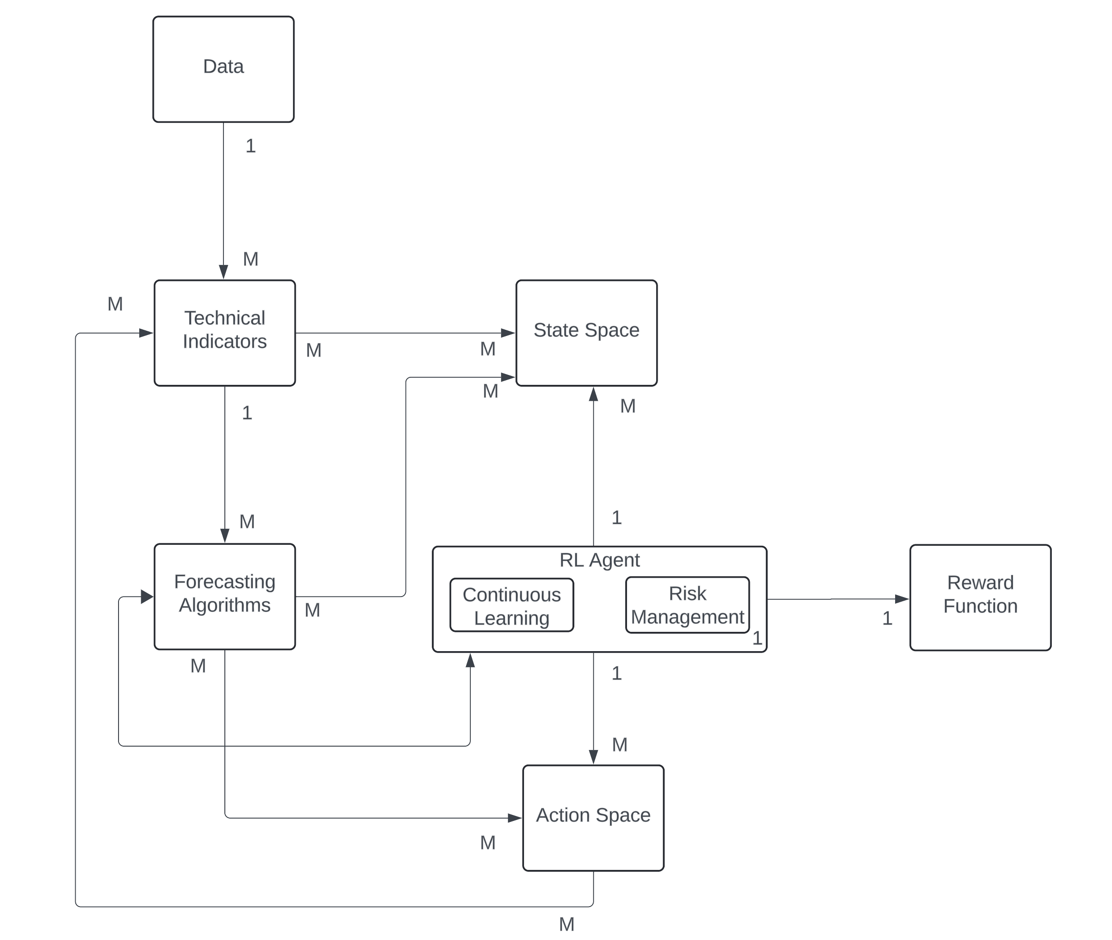
Notes:
The Stocks component provides raw market data (e.g., prices, volumes, etc.) to the Market Data Pipeline.
Data -> Indicators -> forecast algos
• The Market Data Pipeline processes raw stock data to generate usable features, which are then sent to:
• Technical Indicators (for calculating indicators like moving averages, RSI, etc.).
• State Space, which also receives the processed data for its environment.
• The Technical Indicators component outputs derived metrics like volatility, moving averages, etc., to the State Space.
• The State Space (which holds the complete view of the current market environment) feeds contextual data, including historical market conditions, indicators, and stock data, to the Reinforcement Learning (RL) Agent.
Risk Management Module, which enforces rules like stop-loss strategies, and other risk measures. This component prevents high-risk actions.
• The Continuous Learning Module allows for learning and retraining of the RL agent based on new market data, ensuring the agent adapts to evolving market conditions.
• Based on the data received from the state space, the RL Agent uses algorithms like Proximal Policy Optimization to make decisions. It sends these actions (buy, sell, hold, portfolio optimizations, etc.) to the Action Space.
• The Action Space executes the decisions made by the RL agent, which influences the market (hypothetically), and the outcomes (new market data) are fed back into the Market Data Pipeline.
• The Reward Function provides feedback to the RL Agent by calculating rewards based on profit, risk-adjusted returns (such as the Sharpe ratio), and risk metrics (e.g., drawdowns).
• The feedback helps the agent learn and adjust its strategy for future actions.
• After the RL agent’s decisions are executed in the Action Space, the market data gets updated, and the loop continues as the Market Data Pipeline collects this information for further analysis and decision-making.
Feedback Loops:
• Market Data → State Space → RL Agent → Action Space → Market Data: This is the main interaction loop where the RL agent continuously makes decisions, and their results are reflected in the market data.
• Reward Function → RL Agent: Feedback from the reward function helps the agent adjust and optimize its decision-making process for future states.

Slide 19
Architecture Model

Slide 20
Data Foundations
Data Ingestion
Data Preprocessing and Feature Engineering
Database

Slide 21
Intelligence Core
Machine / Deep Learning Baseline Models
RL Agent
Algorithms
Notes:
Machine/Deep Learning:
Utilizes advanced algorithms for predictive modeling.
Adapts to market dynamics and learns from new data.
Continuous improvement of models for better accuracy.
RL Agent:
Processes historical and real-time data to make data-driven trading decisions.
Learns optimal actions by maximizing the reward function.
Simulates various trading strategies to identify the most effective ones.
Algorithms:
Optimization of trading strategies based on machine learning insights.
Designing trading signals that capture market opportunities.
Rigorous backtesting to validate strategies before live-market execution.

Slide 22
User Interface
User Interface
Feedback Loop
Testing and Documentation
Notes:
User Interface:
Will have a interactive dashboard for visualization.
Real-time display of market analytics and different types of strategies to try out
Feedback Loop:
takes user feedback and adjustments for system refinement.
Allows for customizations and preferences in the trading strategy.
Feedback will be used to fine-tune models and improve future predictions.
Presents analyzed data and insights in an accessible format.
Delivers clear trading signals for user execution.
Facilitates evaluation of the system’s performance and strategy effectiveness.

Slide 23
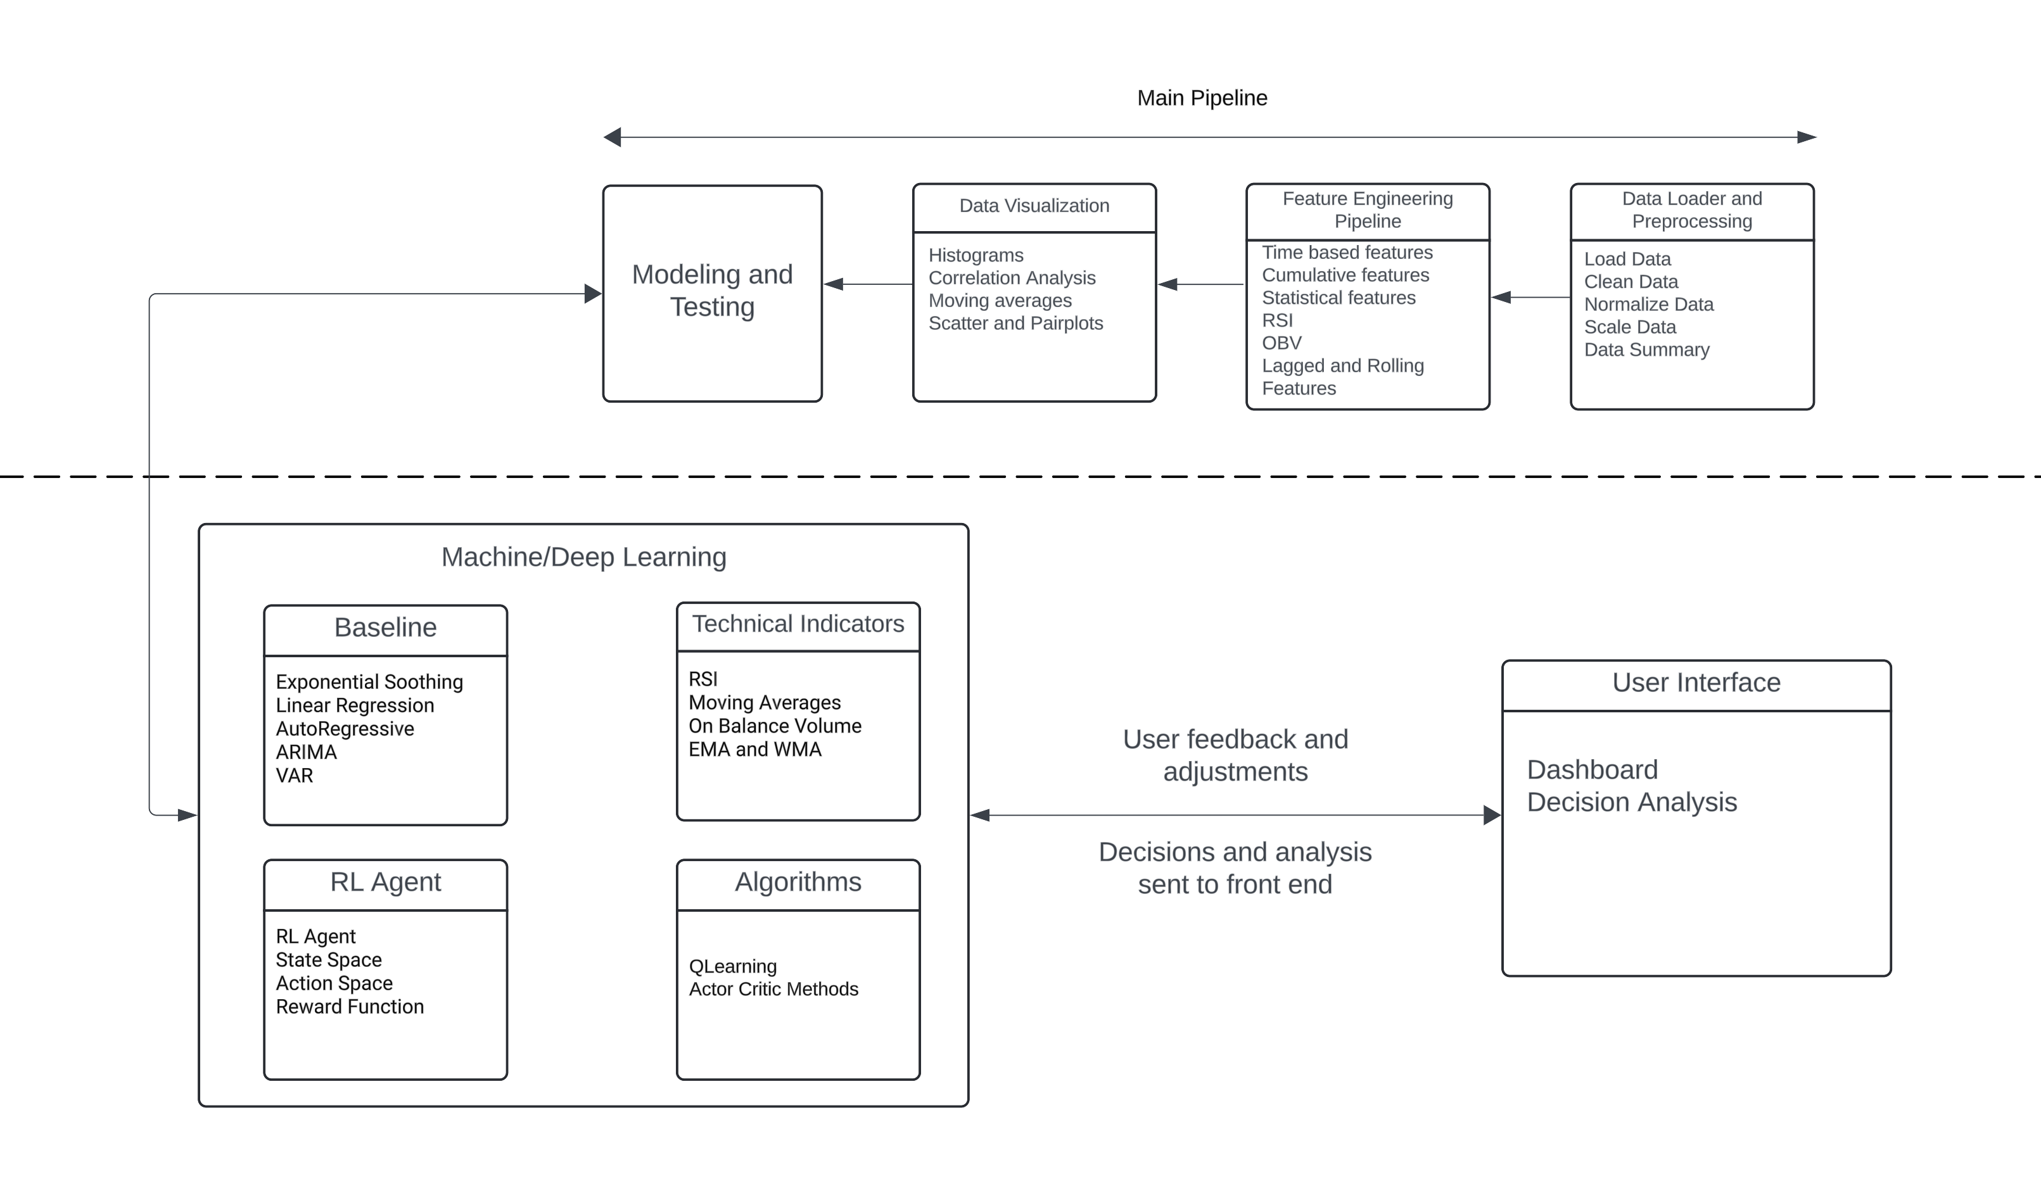
Notes:
2 major updates
Pipeline for the data ingestion and processing
In ml module, more clarity
Rl agent trained on specific strategies
The core learning mechanism, which could use algorithms like Q-learning or Actor-Critic to model the agent’s decision-making process.
Q-learning is a value-based RL method where the agent learns a Q-value for each state-action pair, representing the expected future reward of taking a particular action in a given state.States: The agent’s observations of the market (e.g., price trends, indicators).
Actions: Buy, sell, or hold a stock.
Reward: Profit or loss from each trading action.

Slide 24
GitHub and Demo

Slide 25
Deliverables
Forecasting Algorithms [Almost]
AR, ARIMA, VAR
LSTM
Pipeline Dev
DataLoader, DataPreprocessing, FeatureEngineering [Done]
DataModeling, Testing [Pending]

Slide 26
Deliverables By Stand up III
Finalize RL algorithm
Integration of TSA and RL
Basic UI for the project
Notes:
Basic Strategy Implementation:
• Code basic momentum strategy using indicators such as RSI or moving averages.
• Code the trend-following strategy using moving averages or other trend indicators.
• Backtesting Module:
• Develop a simple backtesting environment where the momentum and trend strategies can be run over historical data.
• Generate performance metrics (returns, drawdown, Sharpe ratio, etc.).

Slide 27
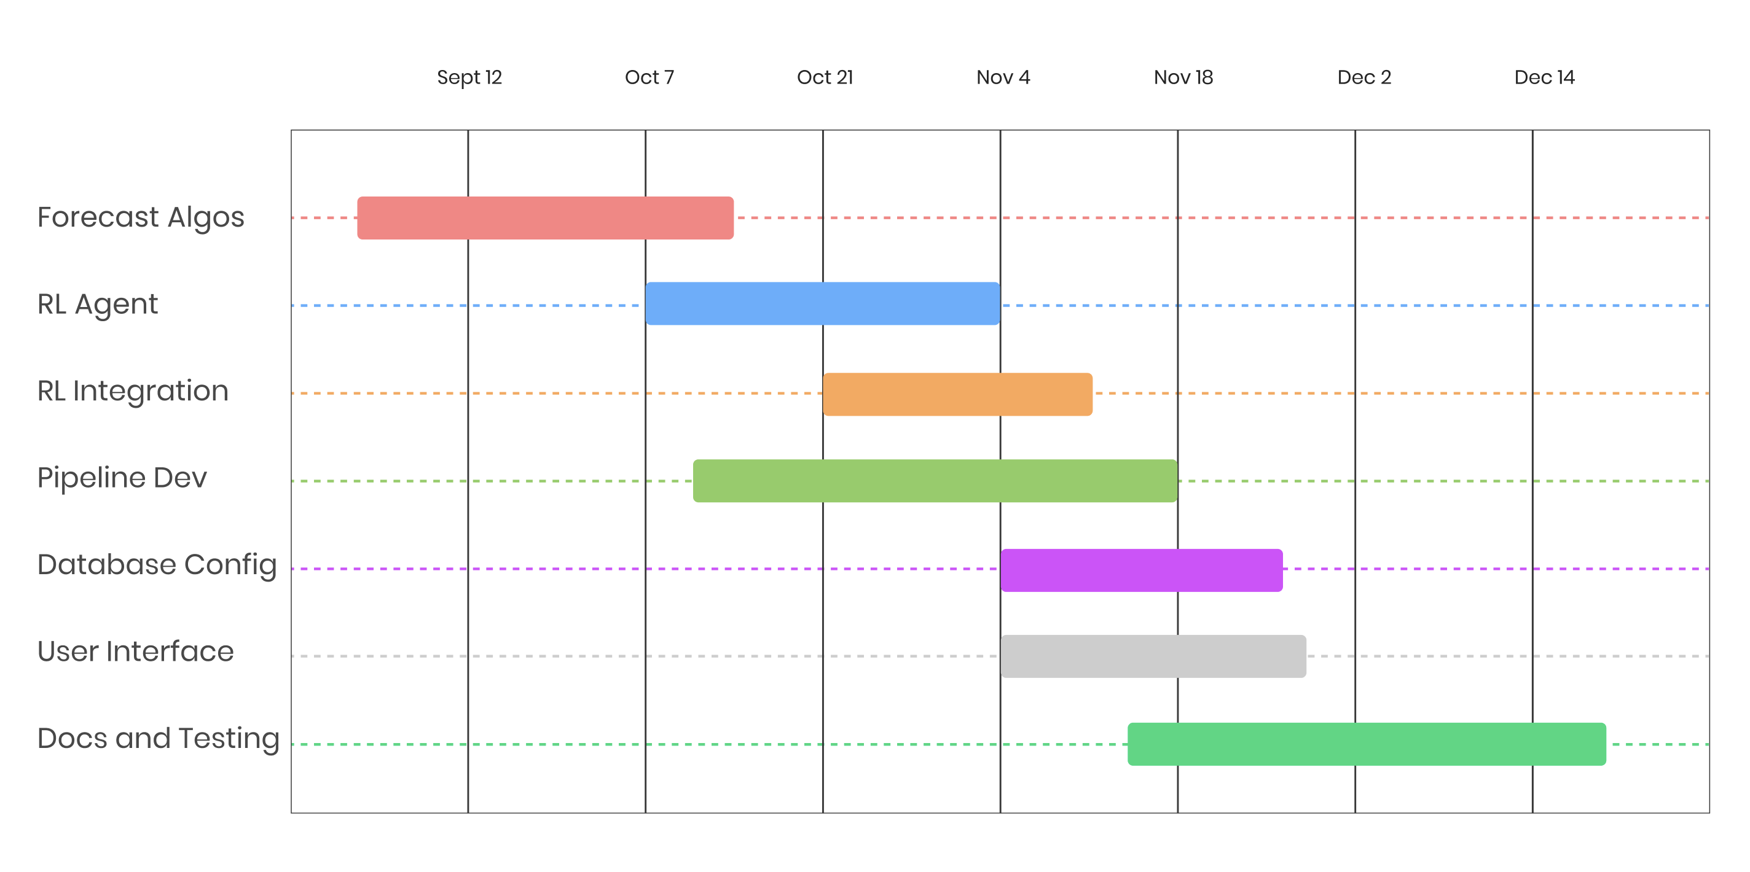
Gantt Chart

Slide 28
Thank you

Slide 29
Deliverables
Trend strategy simulations [Started]
Momentum based
Mean Reversion
Simple MA Crossover
Breakout Strategies
Notes:
Basic Strategy Implementation:
• Code basic momentum strategy using indicators such as RSI or moving averages.
• Code the trend-following strategy using moving averages or other trend indicators.
• Backtesting Module:
• Develop a simple backtesting environment where the momentum and trend strategies can be run over historical data.
• Generate performance metrics (returns, drawdown, Sharpe ratio, etc.).

Slide 30
Deliverables
RL Agent and Integration [Started]
RL Environment Setup
Agent Selection and comparison
Training Agent and performance comparison
Basic Integration
Notes:
RL Environment Setup:
• Design the RL environment that simulates the trading process. Define states (technical indicators, market conditions), actions (buy, sell, hold), and rewards (profits, Sharpe ratio, etc.).
• RL Agent Selection:
• Choose and implement a basic RL algorithm (e.g., DQN, PPO, or A2C).
• Integrate the momentum and trend strategy rules as part of the environment.
• Training RL Agent:
• Train the RL agent on a dataset of historical prices to optimize decision-making based on rewards.
• Monitor convergence and adjust hyperparameters to improve the training process (e.g., learning rate, epsilon for exploration).
• Performance Comparison:
• Compare the performance of the RL agent to the baseline momentum and trend-following strategies.
• Evaluate key metrics like cumulative returns, Sharpe ratio, volatility, and drawdowns.
• Basic Integration:
• Ensure the RL agent can be deployed into the simulation pipeline alongside the traditional strategies for real-time testing.

Slide 31
Deliverables
Develop Pipelines to automate processes
Data Cleaning Pipeline
Feature engineering Pipeline
Pipeline Orchestration
Testing and Validation

Slide 32
Deliverables
Database Configuration
Schema Design
Setup
Integration with Pipelines
Notes:
Database Schema Design:
• Design the database schema to store all essential information, including:
• Historical and real-time market data.
• Trade logs and performance metrics.
• User inputs and feedback.
• RL agent decision history and action logs.
• Database Setup (PostgreSQL/Cloud):
• Set up a PostgreSQL or cloud-based database for efficient data storage.
Integration with Pipelines:
• Ensure seamless integration between the data pipelines and the database, allowing data ingestion and processing results to be stored and accessed efficiently.

Slide 33
Deliverables
User Interface
Basic Wireframe
UI Dev after finalizing framework
Reporting and exporting functionality
Notes:
UI Wireframe and Planning:
• Create a basic wireframe or mockup of the user interface using tools like Figma or Balsamiq.
• Identify and prioritize core features such as displaying market data, strategy performance, and RL agent results.
• Basic UI Development:
• Begin developing the UI using frameworks such as React.js or Dash.
• Implement core visualizations (e.g., charts, graphs) to show strategy performance (momentum and trend).
• Display basic metrics such as cumulative returns, Sharpe ratios, and trade logs.
• User Interaction Features:
• Allow users to interact with the UI by adjusting strategy parameters (e.g., window lengths for moving averages).
• Data Visualization:
• Integrate real-time data visualization, allowing users to see strategy performance updates in near real-time.
• Include historical performance graphs, risk metrics, and comparison plots between different strategies.
• Reporting and Export Functionality:
• Add a feature to generate reports and export results (e.g., PDF or CSV) with performance metrics, trade histories, and visualized charts.

